Slide 1
PROJECT TITLE
MEDICINE MANUFACTURING ANALYTICS AND WASTE REVENUE ESTIMATOR

Slide 2
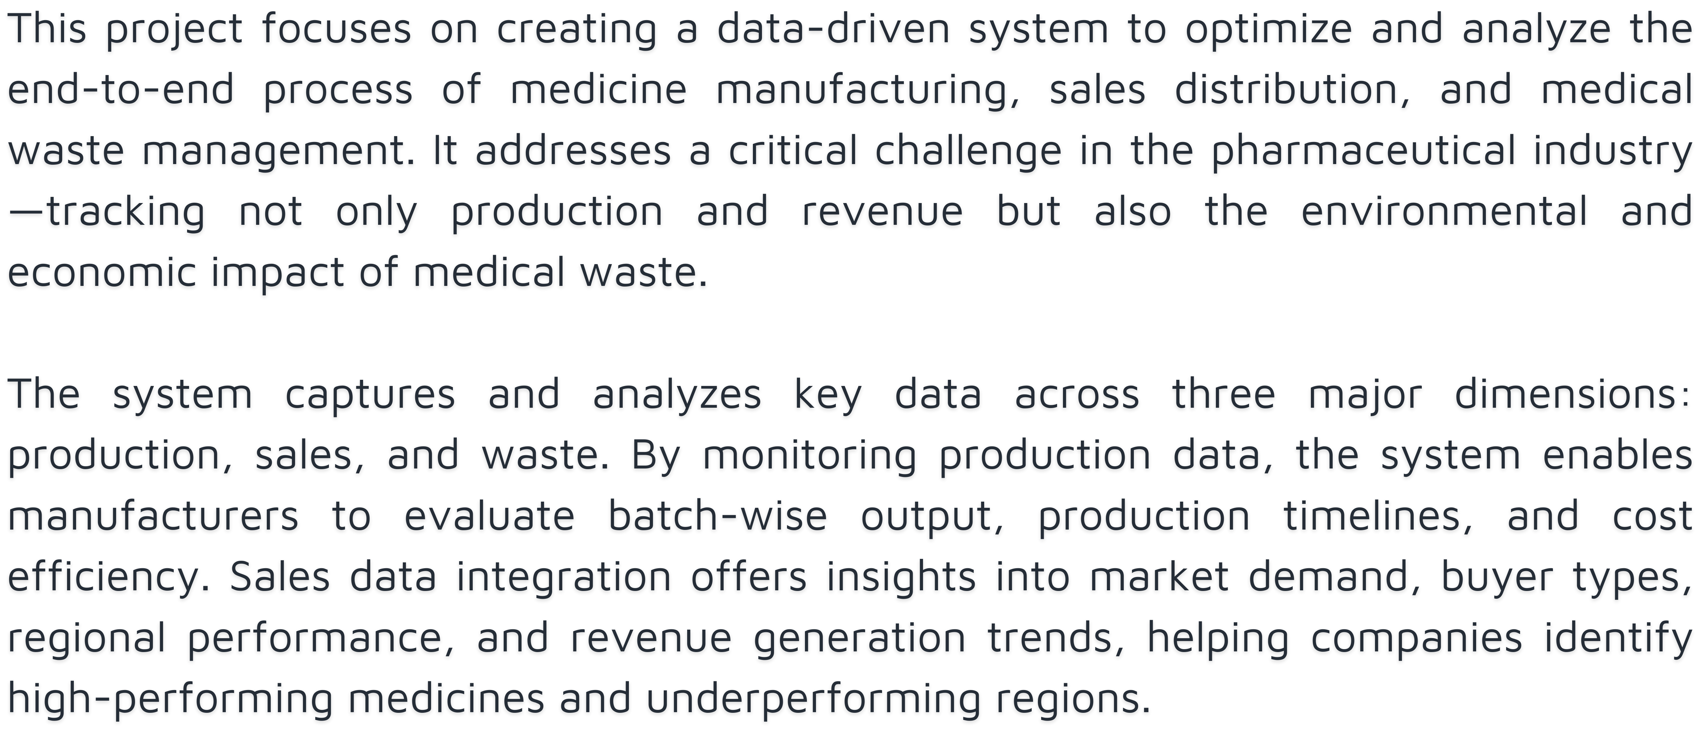
DESCRIPTION

Slide 3
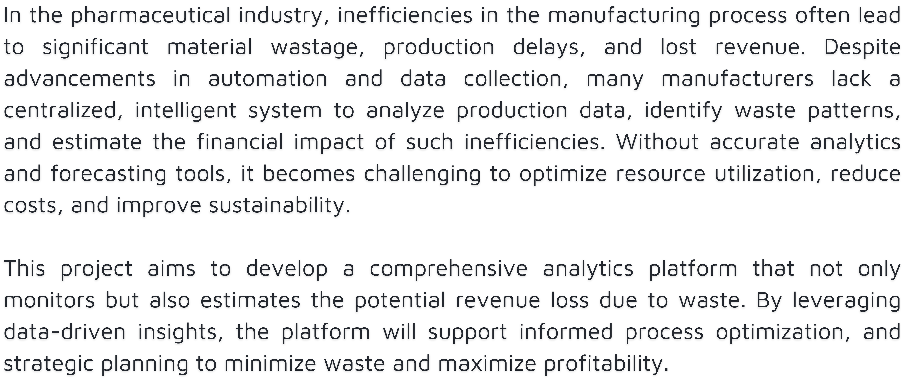
PROBLEM STATEMENT

Slide 4
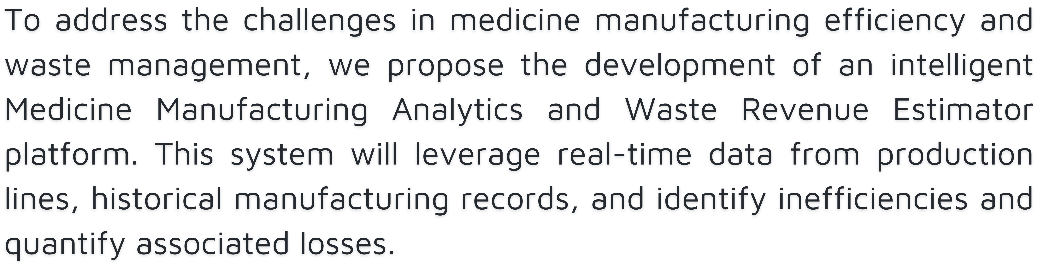
PROBLEM SOLUTION

Slide 5
EXISISTING SOLUTION
Several pharmaceutical companies and industrial technology providers have already implemented systems to improve efficiency and reduce waste in manufacturing
Such AS -
Manufacturing Execution Systems (MES) Enterprise Resource Planning (ERP) Systems Data Analytics Platforms for Manufacturing

Slide 6
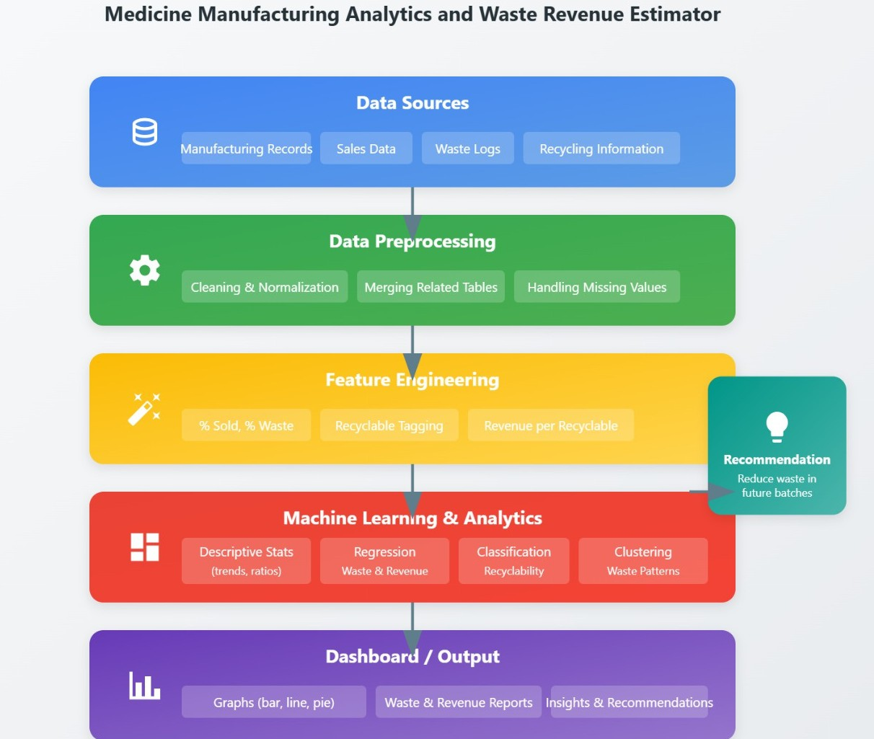
A
R
C
H
I
T
U
R
E

Slide 7
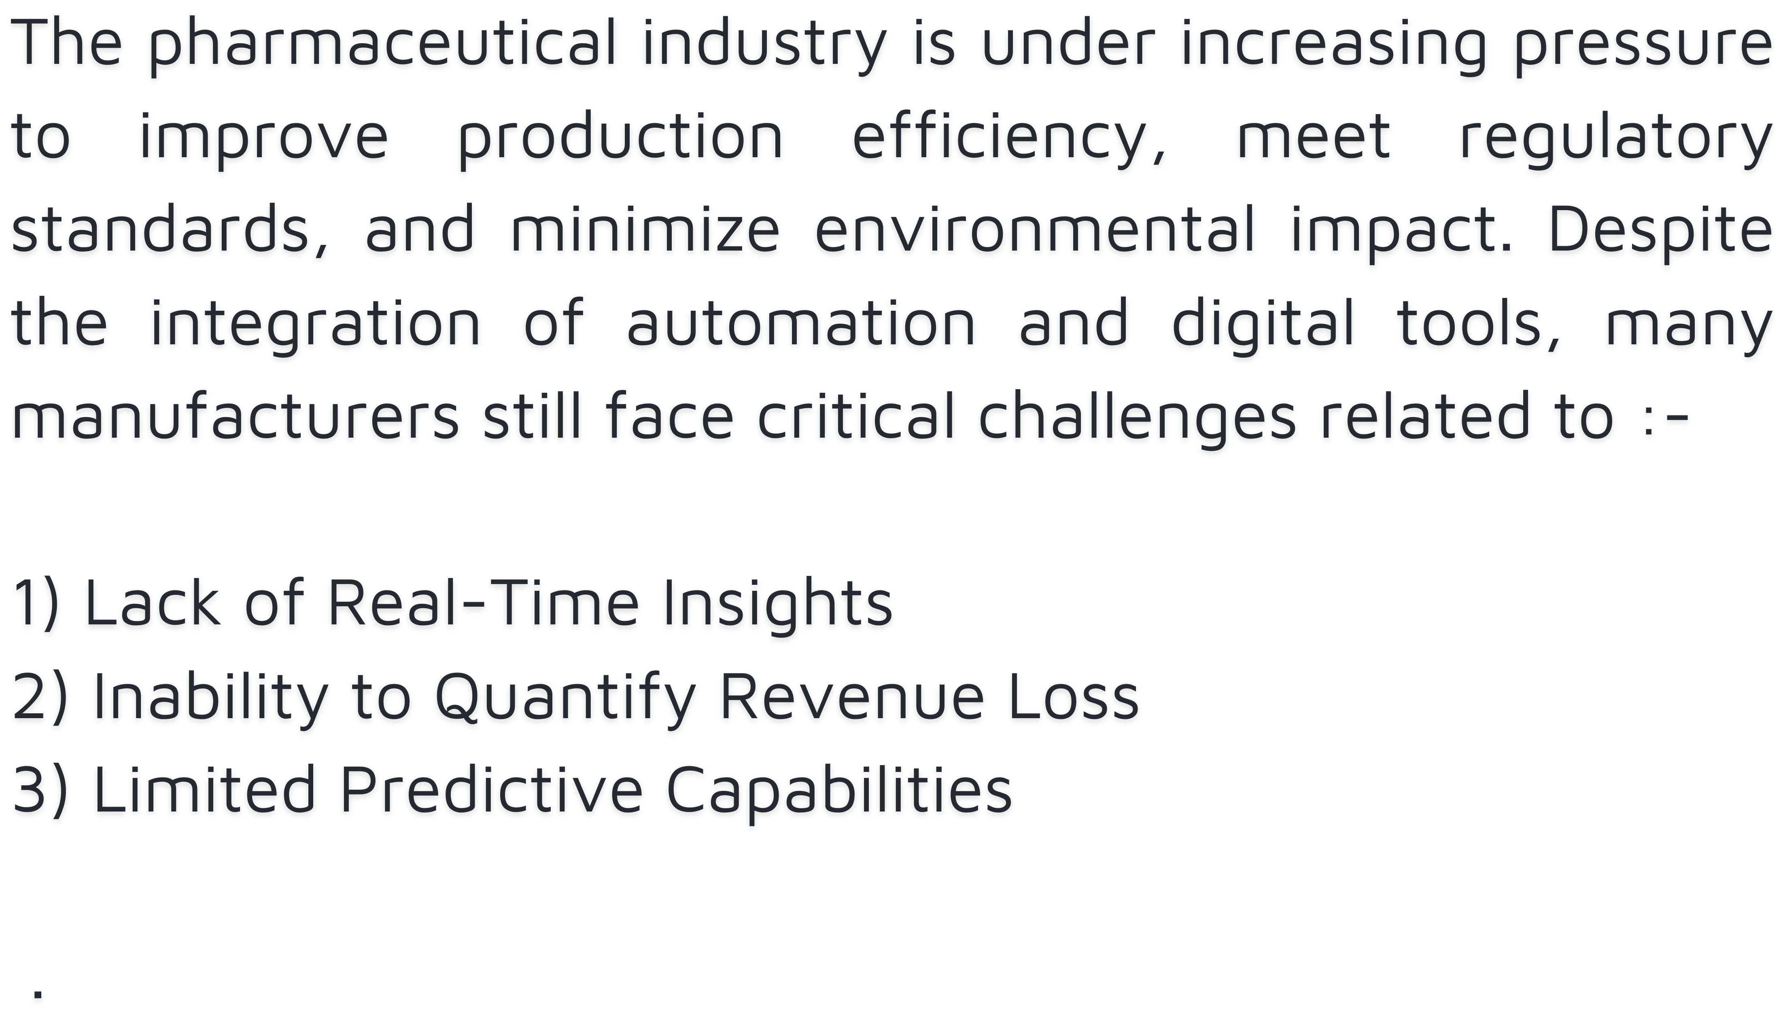
PROBLEM EVALUATION

Slide 8
SOFTWARE AND
HARDWARE INTERACTION
Software
Python
Pandas, Numpy
Matplotlib, Seaborn
Scikit-Learn
Joblib
Jupyter Notebook
CSV Files
Hardware
Barcode/RFID Scanner
Manufacturing Machines
Sensors (Optional IOT)
Industrial PC Or Edge Device
Cloud Server (Optional)

Slide 9
RESULT
10
Improved Operational Efficiency
Cost Savings
Revenue Loss Estimation
Optimized Resource Utilization
Better Quality Control
8
6
4
2
0
Item 1
Item 2
Item 3

Slide 10
Thank You

